Slide 1





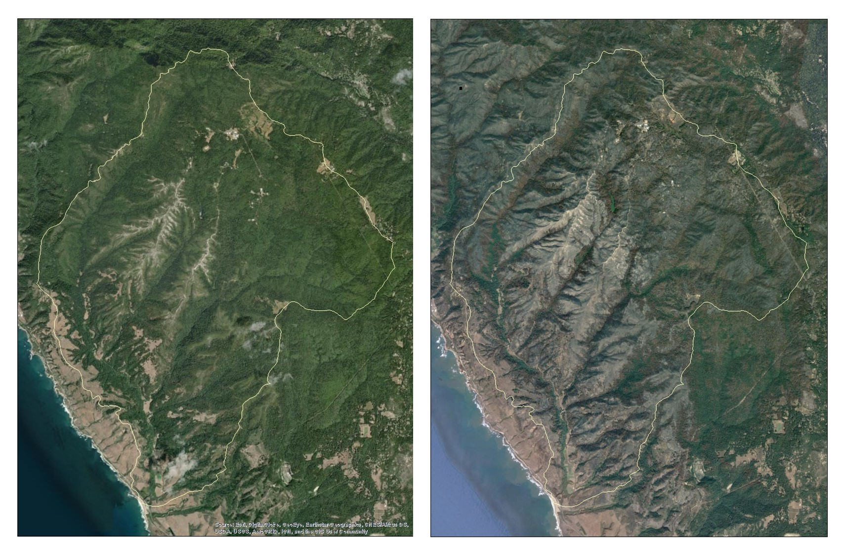
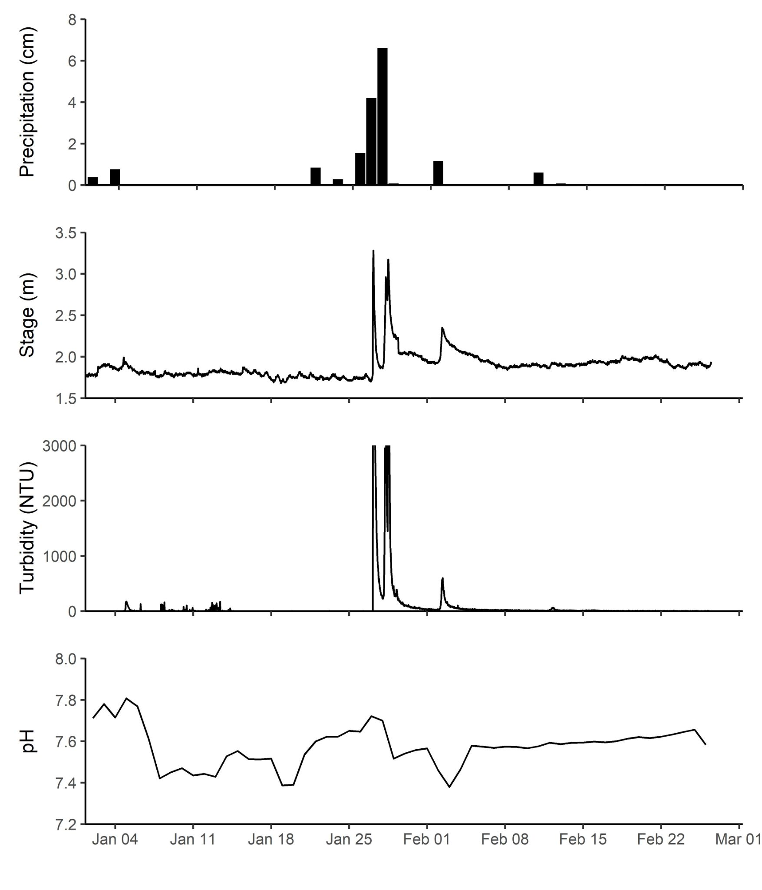
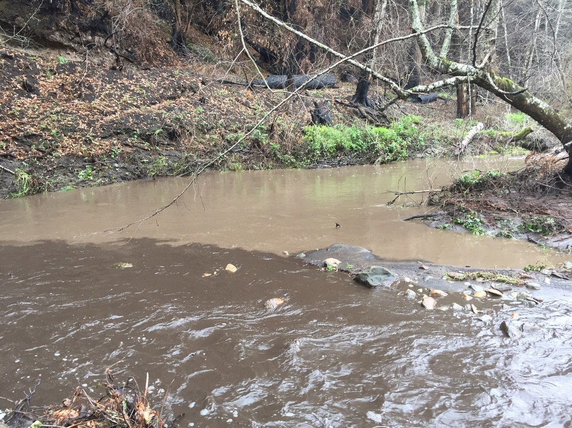
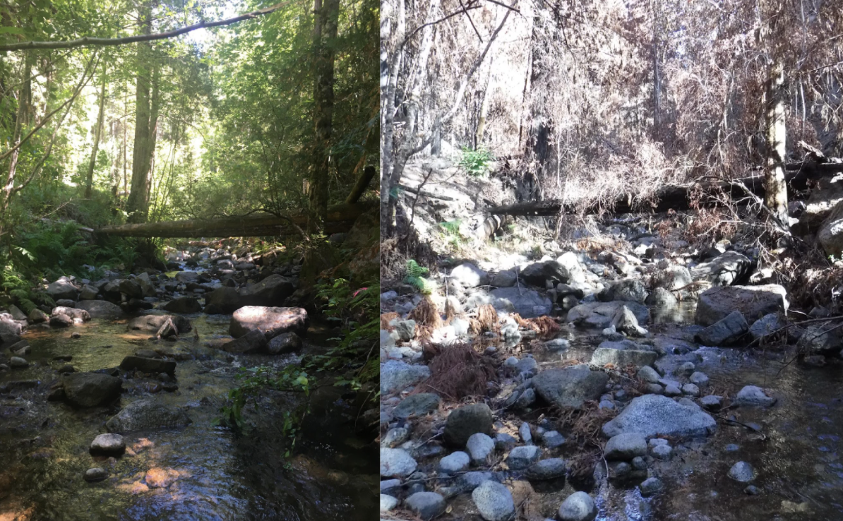
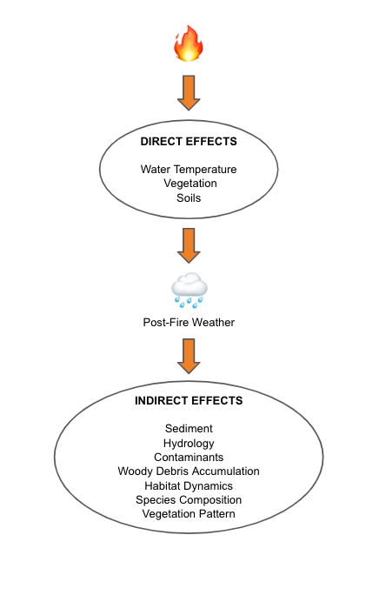
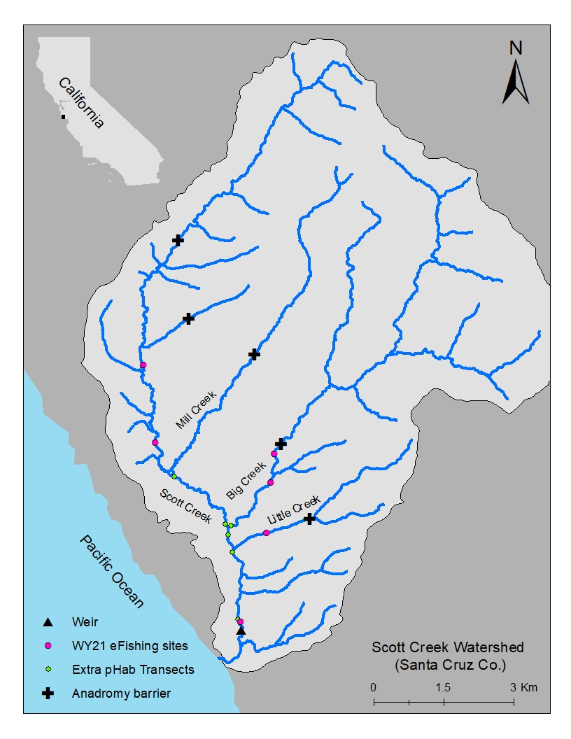
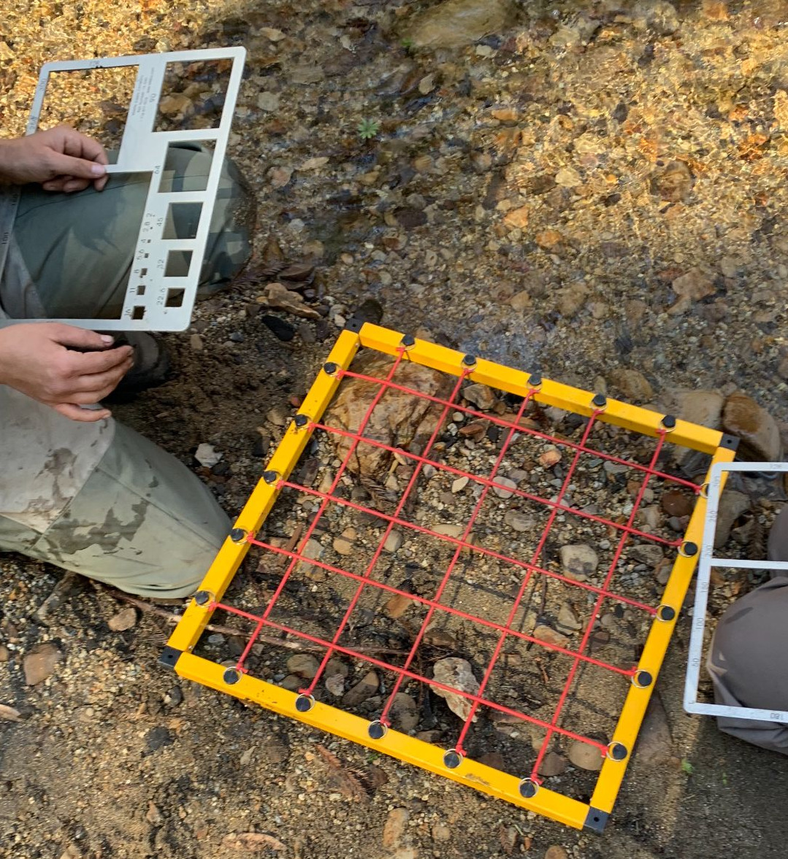
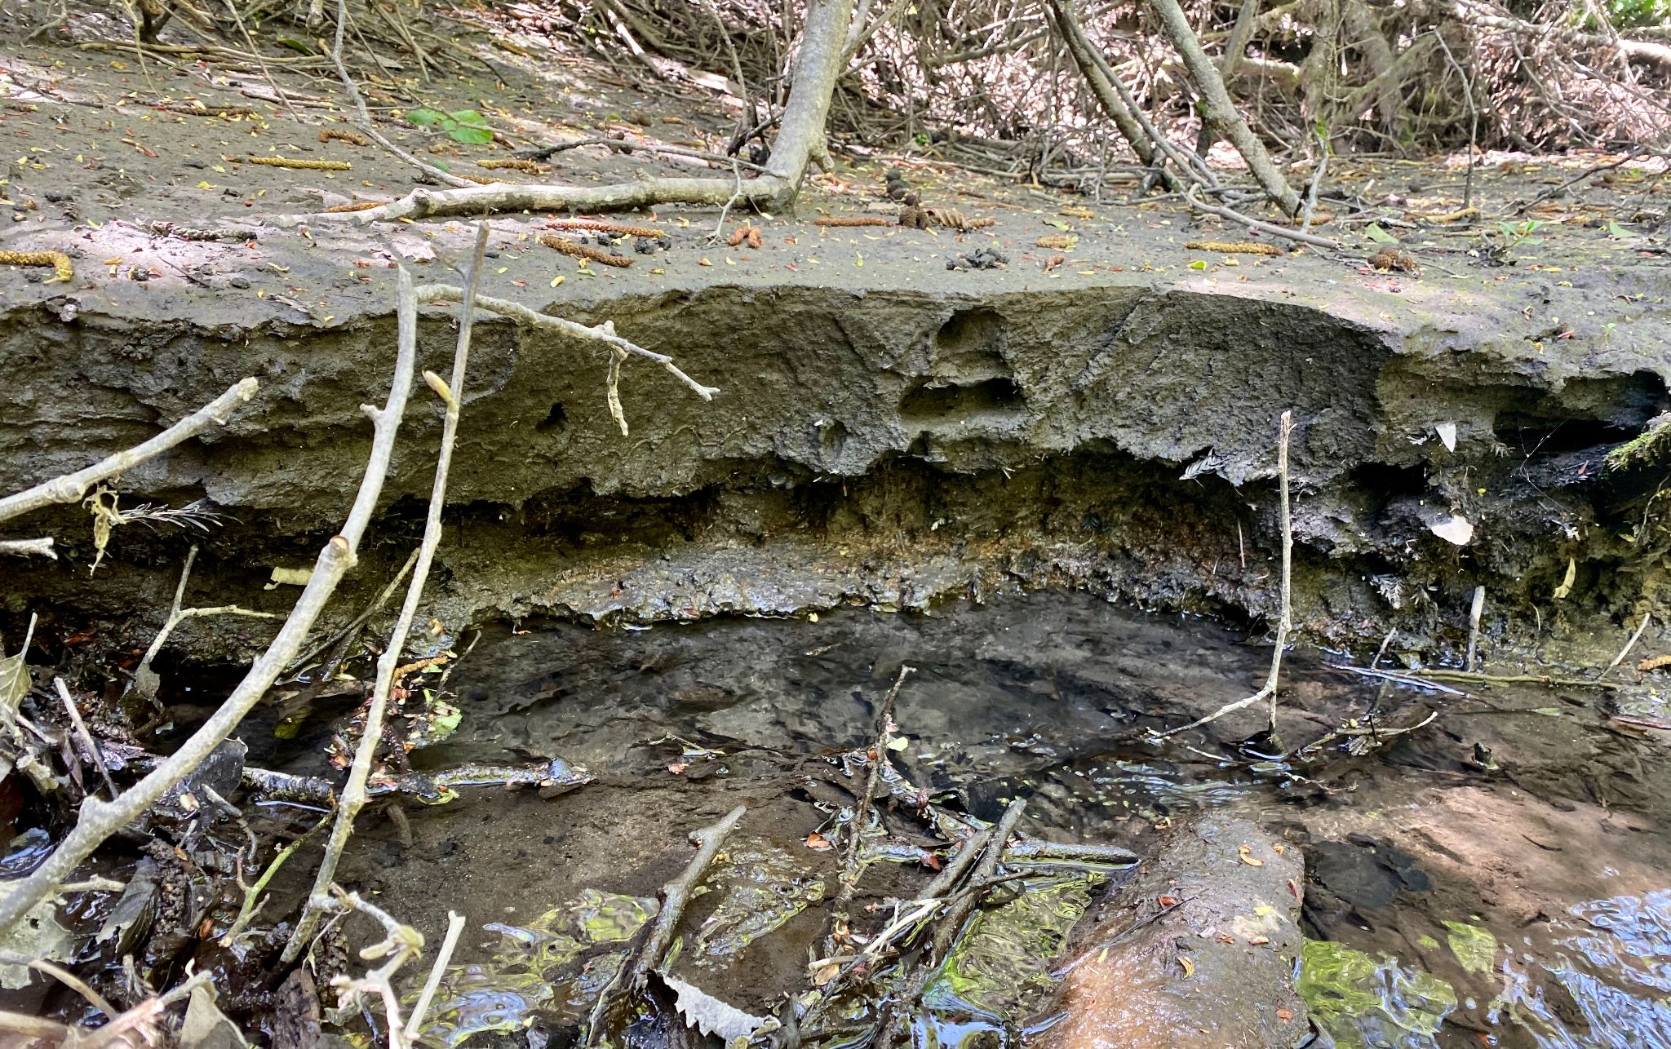
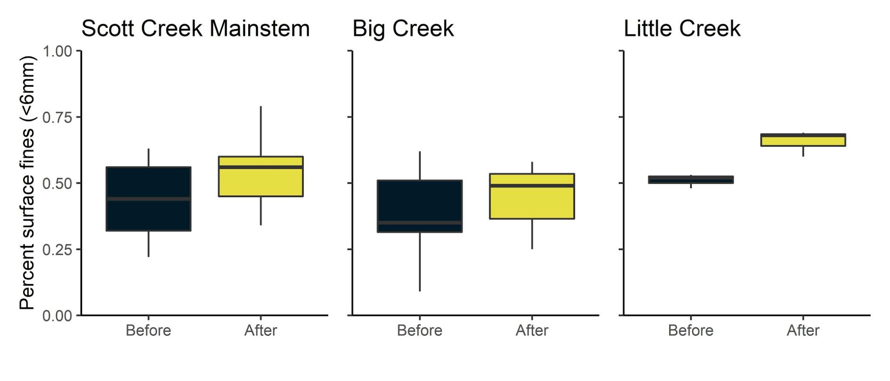
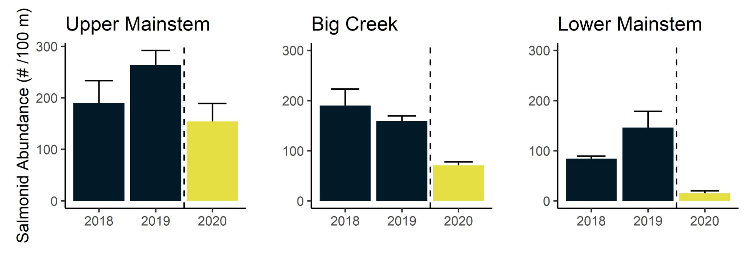


Fire & First Flush Effects on Salmonid Habitat in a Coastal Watershed
Marelle Arndt¹, Rosealea Bond^{2,3}, Adrienne Chenette¹, Cynthia Kern^{2,3}, Joseph Kiernan^{3*}
¹Watershed Stewards Program of the California Conservation Corps and Americorps, Placed at NOAA Southwest Fisheries Science Center, Santa Cruz
²Fisheries Collaboration Program, Institute of Marine Sciences, University of California, Santa Cruz
³Fisheries Ecology Division, Southwest Fisheries Science Center, NMFS, NOAA, Santa Cruz, CA.
*Correspondence to: joseph.kiernan@noaa.gov
Introduction
In August 2020, the CZU Lightning Complex fire burned more than 350 km² (86,500 acres) of coastal forests and hills in the Santa Cruz Mountains region (Santa Cruz and San Mateo counties, California). Among the watersheds severely affected by wildfire was Scott Creek, a small (70 km²) coastal basin ~ 80 km south of San Francisco Bay (Fig.1). The Scott Creek watershed is of special management concern as it supports the southernmost extant population of coho salmon (Oncorhynchus kisutch; Central California Coast [CCC] evolutionarily significant unit) in North America, as well as federally threatened CCC steelhead (O. mykiss). Scott Creek is also the location of a salmonid life cycle monitoring station operated jointly by NOAA’s Southwest Fisheries Science Center and the University of California, Santa Cruz. Extensive physical, chemical, and biological monitoring conducted throughout the Scott Creek watershed since 2002 provides a unique opportunity to rigorously examine the direct and indirect effects of wildfire on salmonid productivity and carrying capacity. Here we highlight initial findings from sampling conducted soon after the fire in the fall of 2020, and likewise following the onset of winter rain and the first flush event.
Methods
Figure 1: Right- ESRI Aerial Imagery of Scott Creek watershed pre-fire (Autumn 2019); Left - Google Earth Aerial Imagery of the same extent post CZU fire (September 2020).
Figure 9: Time series of precipitation, stage height, turbidity, and pH. Water quality parameters were collected on lower mainstem Scott Creek.
Figure 10: Extensive sediment flow at the confluence of Big Creek (foreground) and Scott Creek mainstem (background) following the first major post-fire rain event (January 27, 2021).
Physical and biological datasets were collected at previously established 100 m index reaches in the Scott Creek watershed (Fig. 2; pink circles). Five additional reaches were established above and below tributary inputs specifically to monitor and characterize sediment change (Fig. 2; green circles). There were 32 total transect locations.
Data collection timeline:
First round of data collection:
(Post-fire, pre-rain) 10/21/2020–11/23/2020
Salmonid abundance
(3-pass depletion eFishing)
Basal carbon sources (leaf litter)
Pebble counts (Fig. 3)
Habitat typing
% shade
First post-fire rain event: 1/26/2021
Second round of data collection:
Pebble count (2/24/2021–3/4/2021)
Water quality (1/1/2021–present)
Current Outcomes and Future Direction
Extensive watershed-wide increase in fine sediment (<6mm) distribution
Even the smallest rain events are mobilizing fine sediment
Overall % surface fines (<6mm) increased across all sampling locations (Fig. 4)
Sediment deposition (Fig. 6) → habitat degradation¹ → fills in pools, fills in cobbles
Sediment suspension (Figs. 9 & 10) → blocks fish gills, decreases oxygen for fish redds⁴, increases invertebrate drift⁵
General decline in salmonid abundance following the fire
Salmonid abundance declined following the fire but before any rain event (Fig. 8)
Smoke and ash fallout have immediate effects on stream water quality. Concentrations of ammonium, nitrate, and phosphate can increase immediately following ash input²
The Scott Creek system may have experienced increased exposure to these nutrients for at least over one month while the fire burned
Prolonged exposure to these nutrients can lead to food web disturbances and fish toxicity³
More data is needed to understand the impacts of ash input on riverine organisms
Next steps
Comprehensive physical and biological sampling will continue in Summer 2021 and beyond
Pebble counts
Electrofishing
Food web sampling studies
K. Kobayashi
R. Bond
Figure 5: Severe wildfire damage in the riparian zone on Big Creek tributary before (left photo; September 2017) & after fire (right photo; November 2020), looking upstream.
Figure 2: Scott Creek watershed sampling sites.
Figure 3: Sampling frame (0.5 m²) and gravelometer used during pebble count data collection.
Results
Figure 6: Substantial fine sediment deposit on upper Scott Creek mainstem bank following winter storm event, photo taken on April 8, 2021.
Figure 7: Wildfire effects on terrestrial and aquatic ecosystems (modified from Gresswell, 1999).
Canopy loss
Nutrients (Paytan Biogeochemistry Lab)
Fish toxicity (USGS Pacific Coastal
Marine Science Center)
Acknowledgements:
We thank the Scott Creek Team: Alex Hay, Josh Meko, and Jeff Perez for field support. We are grateful to California Polytechnic State University’s Swanton Pacific Ranch and Big Creek Timber Company for providing land access, logistical support, and a secure place to conduct our research. Additional thanks to Katie Kobayashi for the pre-fire field photos.
Literature Cited:
1. Dunham, J.B., M.K. Young, R.E. Gresswell, B.E. Reiman. 2003. Effects of fire on fish populations: landscape perspectives on persistence of native fishes and nonnative fish invasions. Forest Ecology and Management. 178: 183-196.
2. Earl, S.R, & Blinn, D.W., 2003. Effects of wildfire ash on water chemistry and biotia in South-Western U.S.A streams. Freshwater Biology, 48:1015-1030.
3. Gresswell, R.E. 1999. Fire and Aquatic Ecosystems in Forested Biomes of North America. Transactions of the American Fisheries Society, 128:2,193-221.
4. Kemp, P., D. Sear, A. Collins, P. Naden, I. Jones. 2011. The impacts of fine sediment on riverine fish. Hydrological Processes. 25: 1800-1821
5. Minshall, G.W., J.T. Brock, J.D. Varley. 1989. Wildfires and Yellowstone's Stream Ecosystems. BioScience, 39(10): 707-715.
6. Wolman, M.G. 1954. A method of sampling coarse river-bed material. Transactions American Geophysical Union. Volume 35. Number 6. Pp. 951-956.
Figure 4: Box-and-whisker plot showing percent surface fine-sediment (<6mm) increase after the first major post-fire rain event, measured from February 24, 2021–March 4, 2021. Horizontal lines in boxes are medians, box-ends are quartiles, whiskers are 5% and 95% confidence intervals. Before data measured from October 21, 2020–November 23, 2020.
Figure 8: Bar graph showing general decline in total salmonid abundance (+ 95% CI). Data were derived from three-pass depletion electrofishing in three reaches (Upper mainstem, Big Creek, and Lower mainstem) during autumn. 2018 and 2019 data represent pre-fire conditions, whereas 2020 represents post-fire and pre-rainfall.
Notes:
Title was 69
names 62
affiliation 21
headers were 63
intro 32
captions 24
we know the hydrograph is different. it’s behaving differently. we’re seeing over land flow due to loss of veg, despite being a benign storm year

